Slide 1
Dev Rev UI Project
BY
Srihari Rajagopal r
DEPT OF electronics and communication engineering
SONA COLLEGE OF TECHNOLOGY

Slide 2
Problem statement
Build a simple library management page where ● Users should be able to see the list of books ○ Instead of loading all the results on the page, perform paging on the list of books – either implement 10 results per page or load on scroll will be a bonus
Users should be able to filter the list of books based on Title, Author, Subject and Publish - date ○ User should be able to see the count of books in based on each criteria [ Title, Author, Subject and publish-date Don’t stop using your creativity to improve this page.

Slide 3


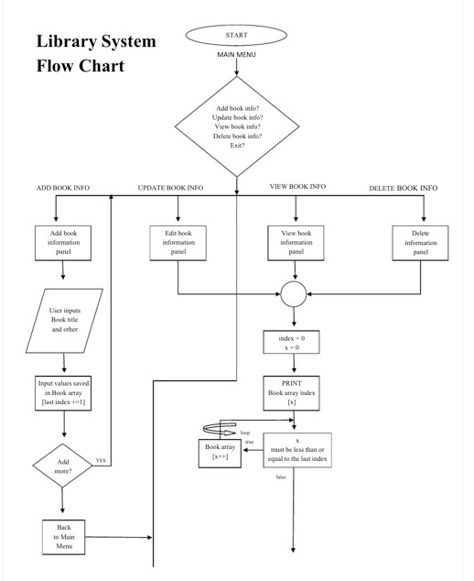




Slide 4
A good Library management project has the following features in it:
An advanced library management system.
Can be adaptable to Windows, Linux and Mac OS stage.
Print your own standardized tags.
Full index, course and acquisitions framework for library stock administration.
Electronic OPAC (Online Public Access Catalog) framework
Straightforward, clear quest interface for all clients
Fare and import records
Simple approach to enter new books
Keep record of complete data of a book like title, writer name, distributer name and so forth

Slide 5
Hardware and Software
Owner Module Attributes The owner needs to have these in the database:
A unique owner ID
Full name
Email Address
Contact information including number and address
Librarian Module Attributes
A particular user ID
Full name
Email address
House Adress and Mobile number.
Reader Module Attributes It needs to have the following details
A unique user ID
A secret password
Full Name
Father’s Name
Email Address
Contact details including house number.
Books Attributes This includes all the details about the total books in the system.

Slide 6
Address Attributes This includes all the addresses in the framework so that any address can be reached in case of emergency, within a click of a key.
Available Books It has a record of all the books that are available to be issued.
Issued books This contains a record of books that have been issued by the readers
Dates This record has all the dates including the ones on which the books have been issued, on which they have been returned and the dates on which the fine was paid etc.
Fines This has all the record of the fines that have been collected.

Slide 7
Thank You
PLACE: Salem
DATE: 25/08/2022

